Slide 1
Bayes' Formula

Slide 2
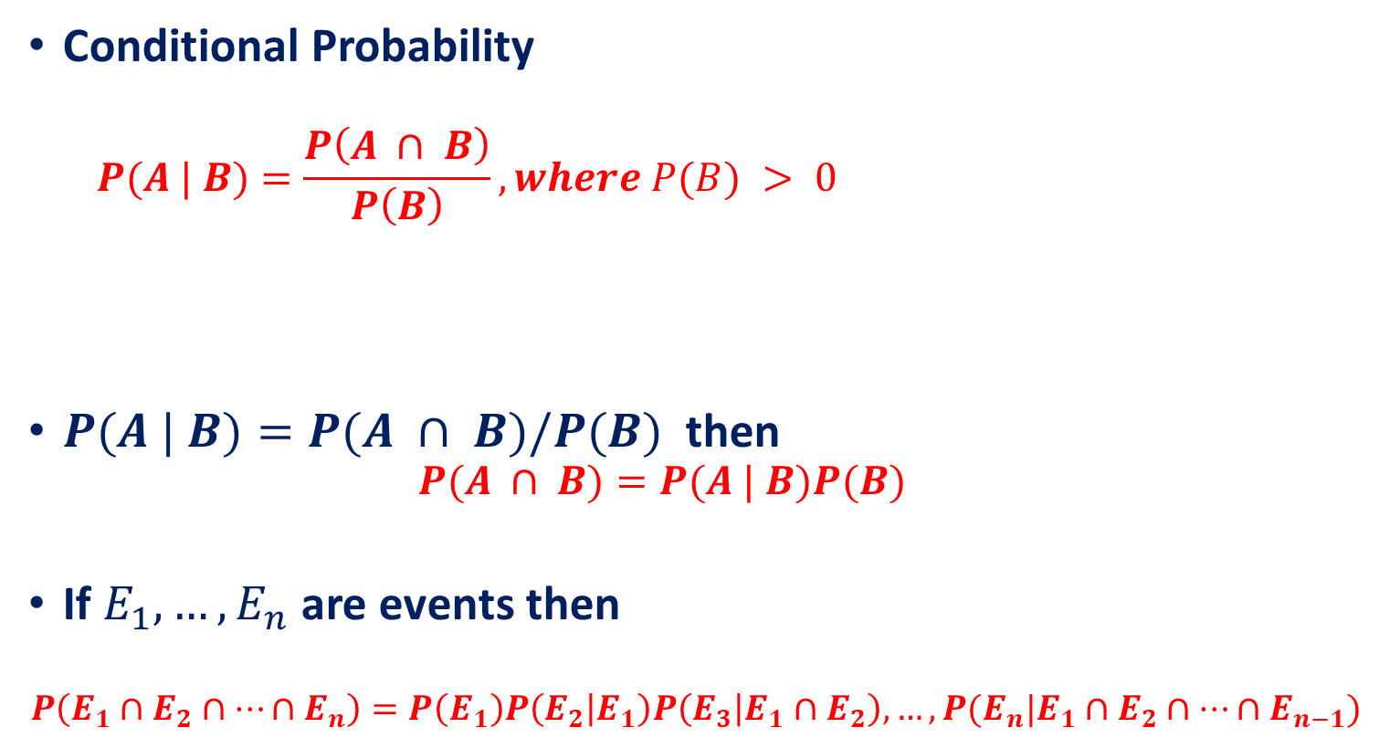
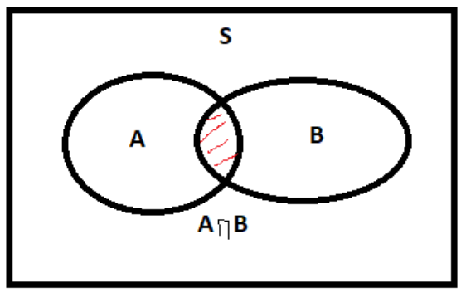
Recall
If P(B)=0, it means that the event B never occurs, so it does not make sense to talk about the probability of A given B.

Slide 3
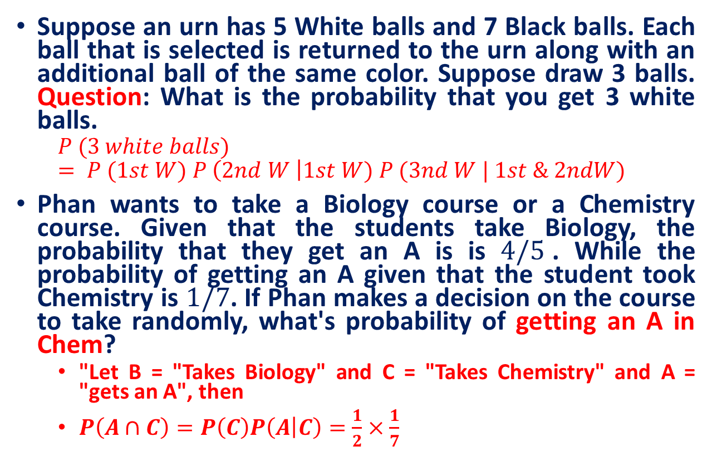
Practice Exercises

Slide 4
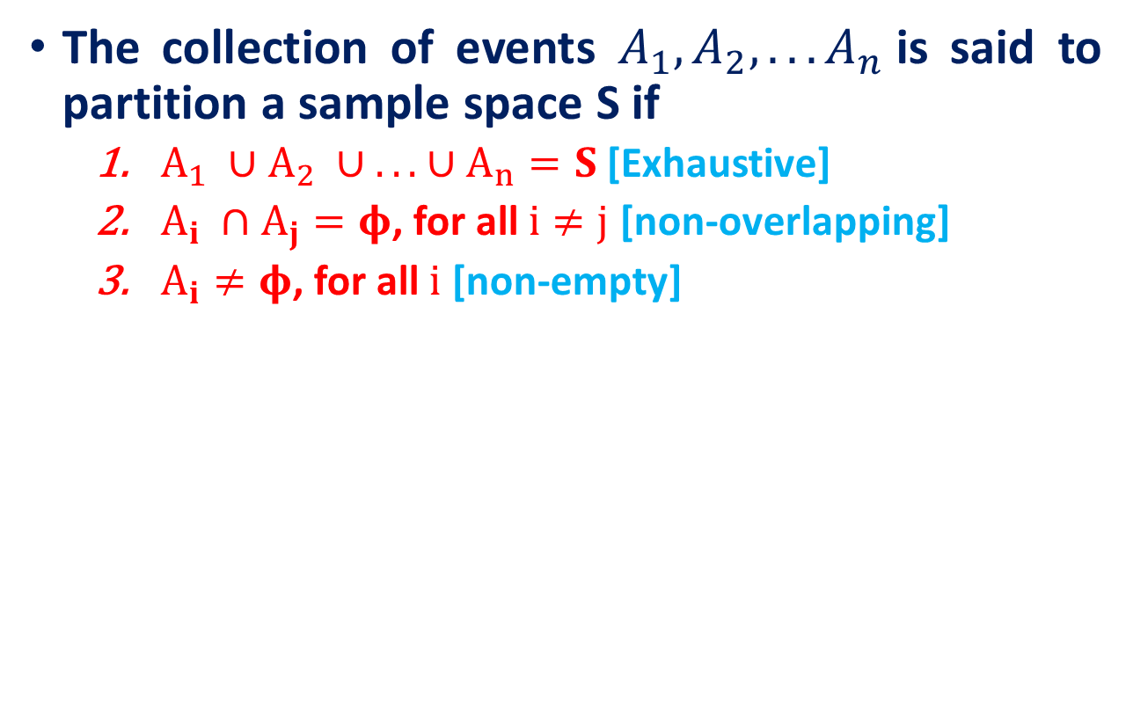
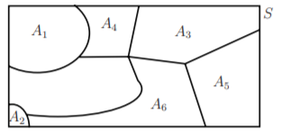
A partition of a sample space

Slide 5
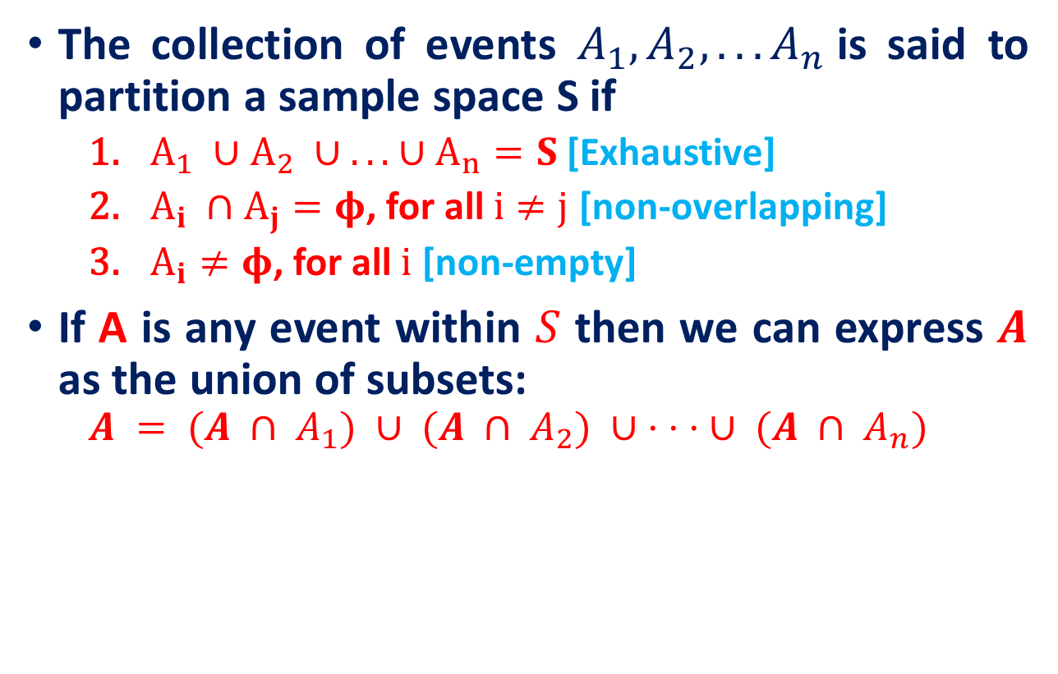
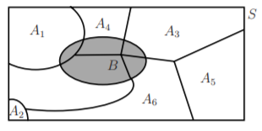
A partition of a sample space
A

Slide 6
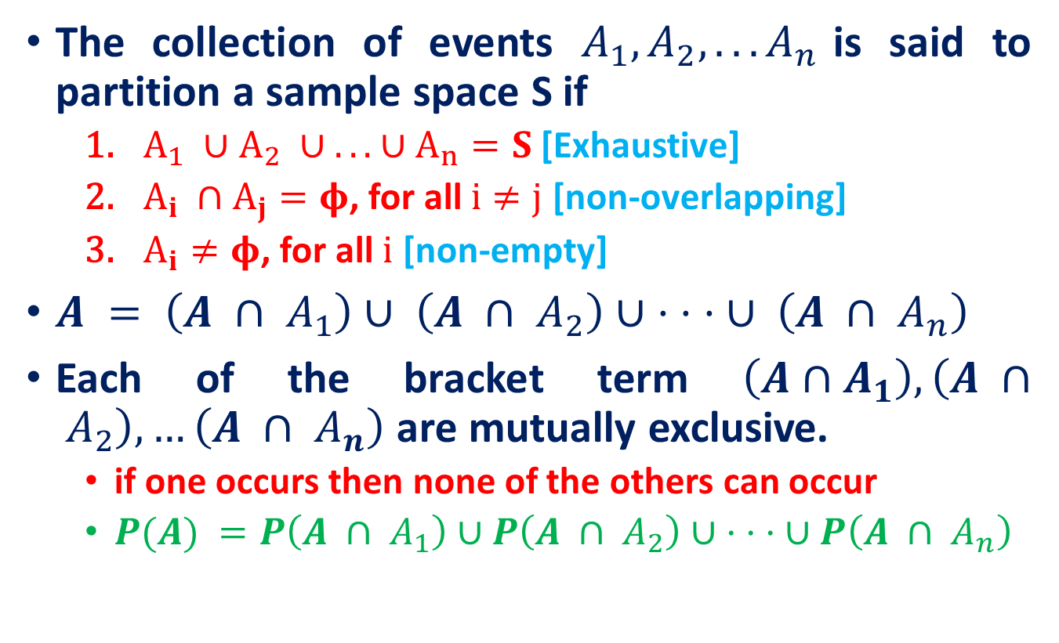
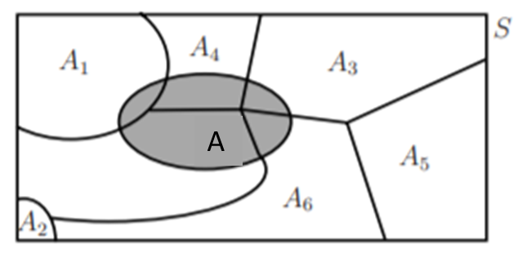
A partition of a sample space

Slide 7
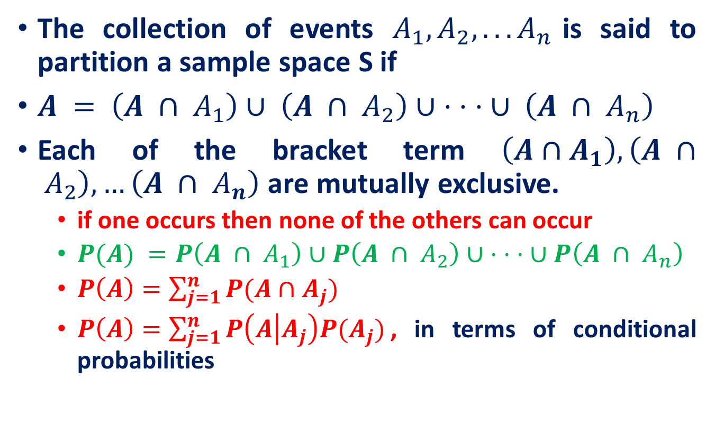
A partition of a sample space

Slide 8
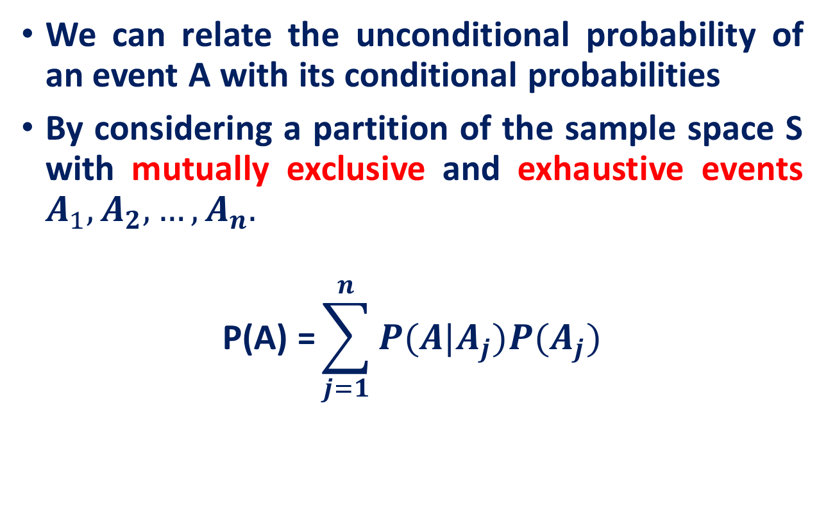


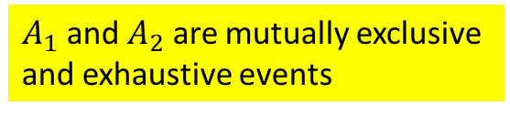
Total Probability Theorem
S: Sample Space
A
A
A
This is the theorem of Total Probability

Slide 9
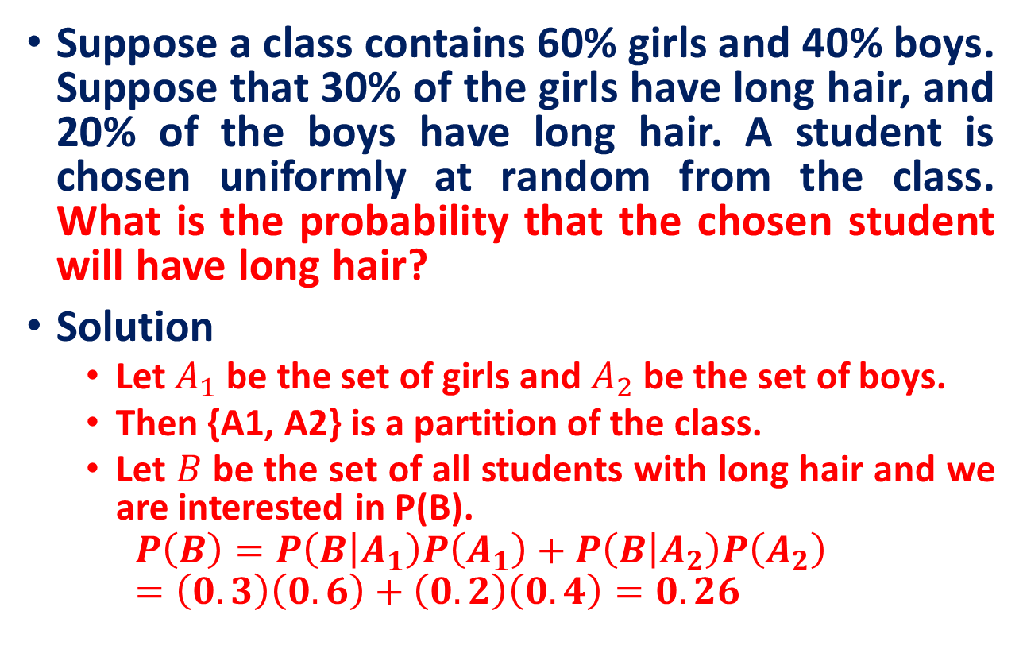
Total Probability Theorem

Slide 10
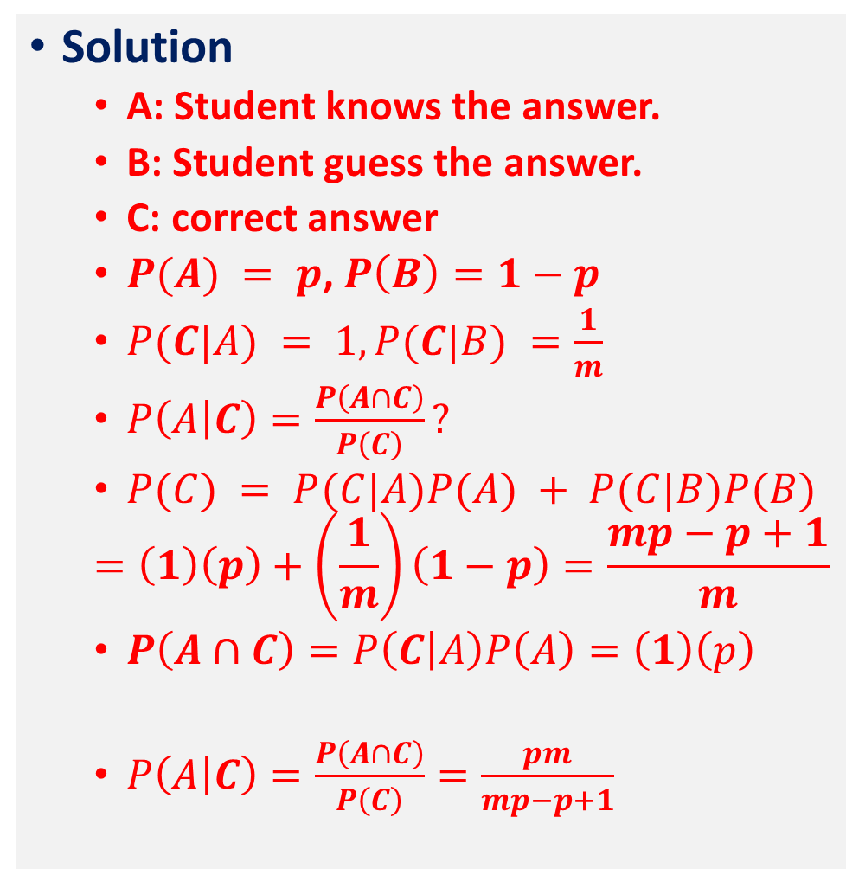
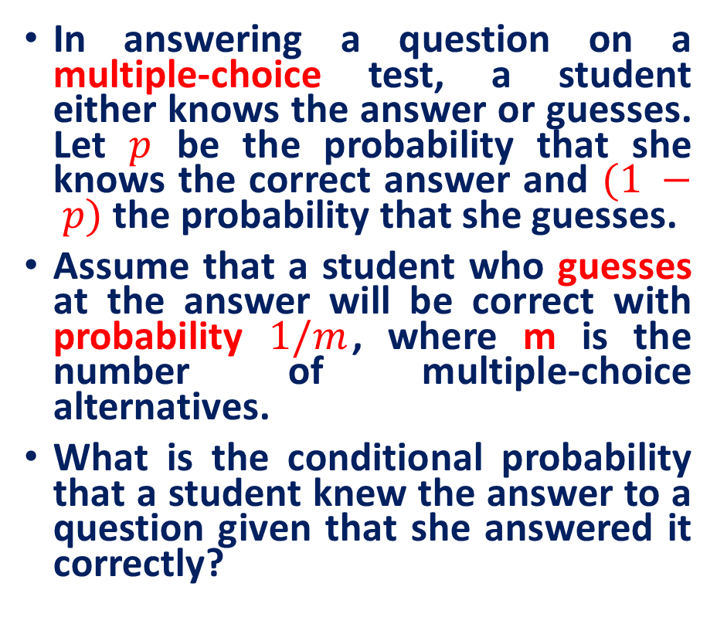
Total Probability Theorem

Slide 11
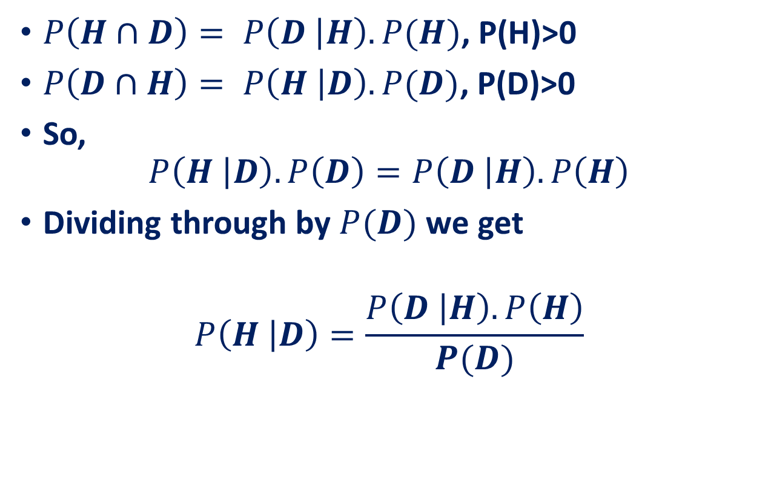
Bayes' Formula
Applications of Bayes’ Theorem: Machine Learning
Naive Bayes Classifier: Find posterior probabilities of Classes
Bayesian Belief Networks : Reasoning with uncertain knowledge
Bayes’ law
This law is important in the cases where we want to know the number on the left, and we do know (or can guess) the numbers on the right.

Slide 12
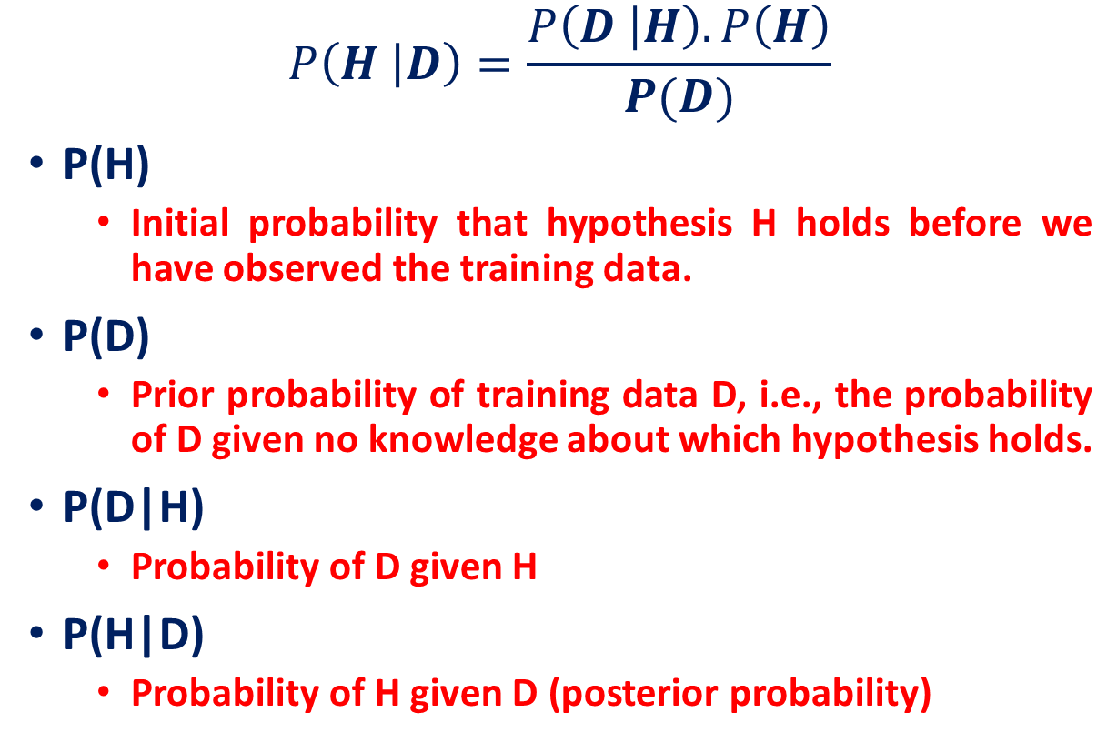
Bayes' Formula
Evaluation of posteriori probability in terms of a priori information

Slide 13
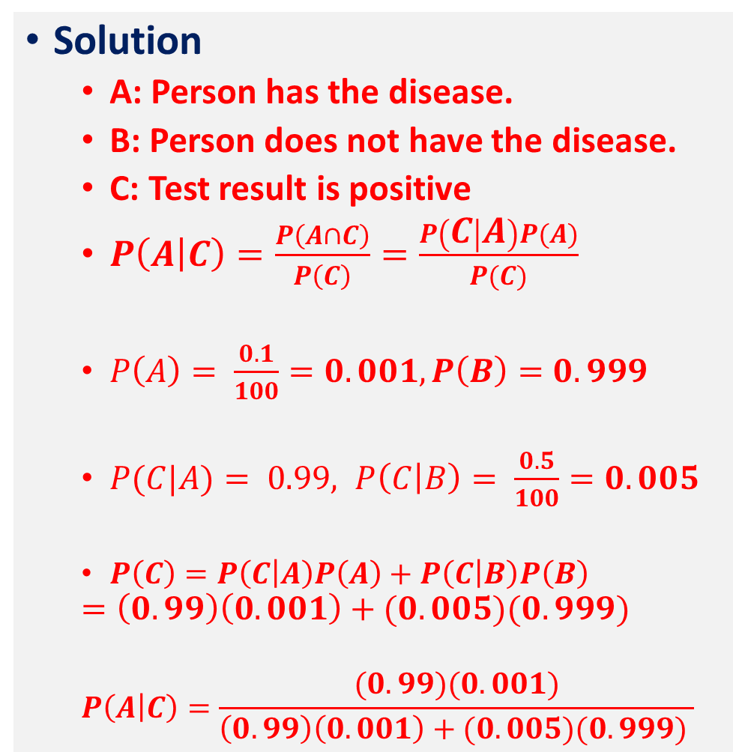
Bayes' Formula
Question
A laboratory blood test is 99 percent effective in detecting a certain disease when it is, in fact, present.
However, the test also yields a “false positive” result for 0.5% percent of the healthy persons tested.
If 0.1 percent of the population actually has the disease, what is the probability a person has the disease given that his test result is positive?

Slide 14
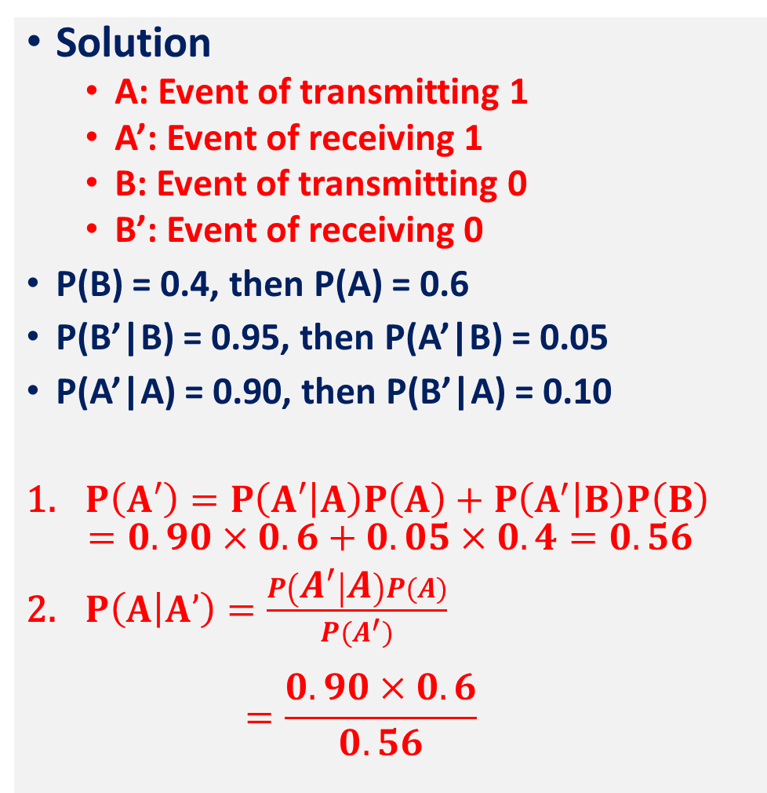
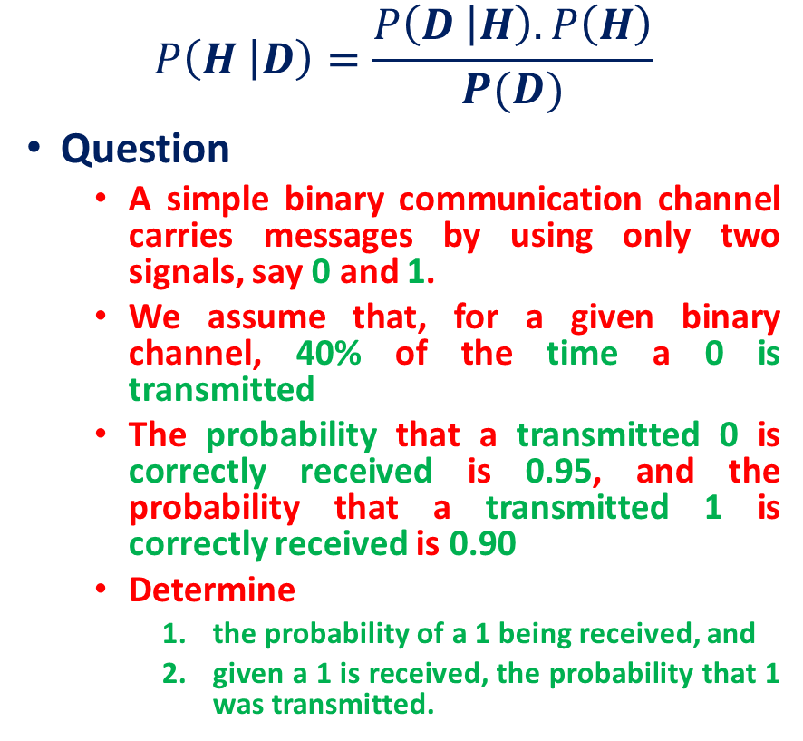
Bayes' Formula

Slide 15
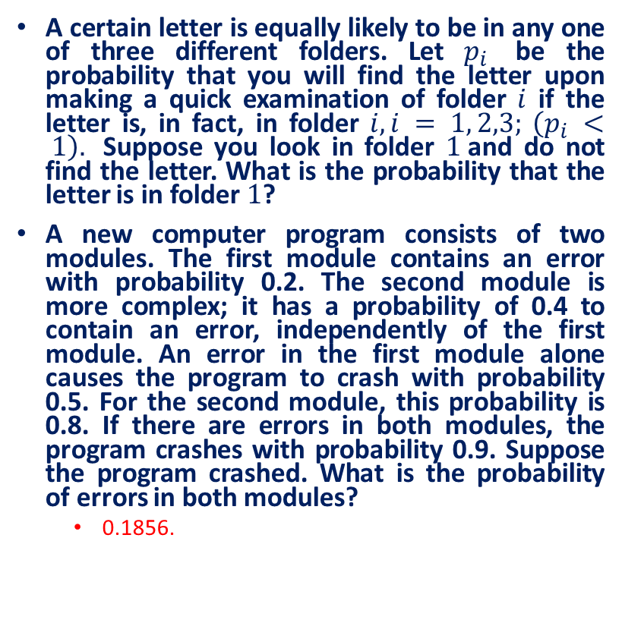
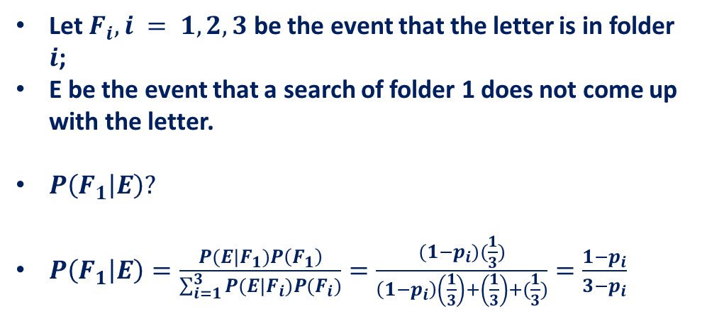
Practice Exercises

Slide 16
Naive Bayes Classifier

Slide 17
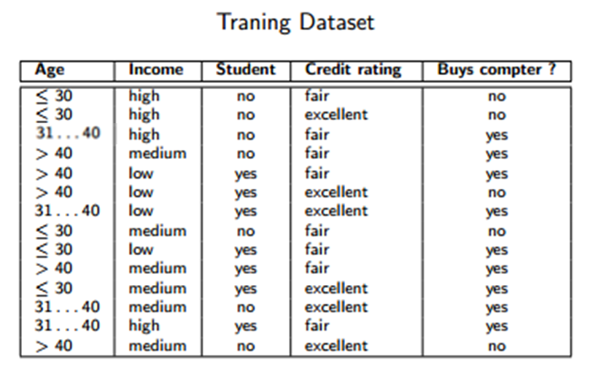
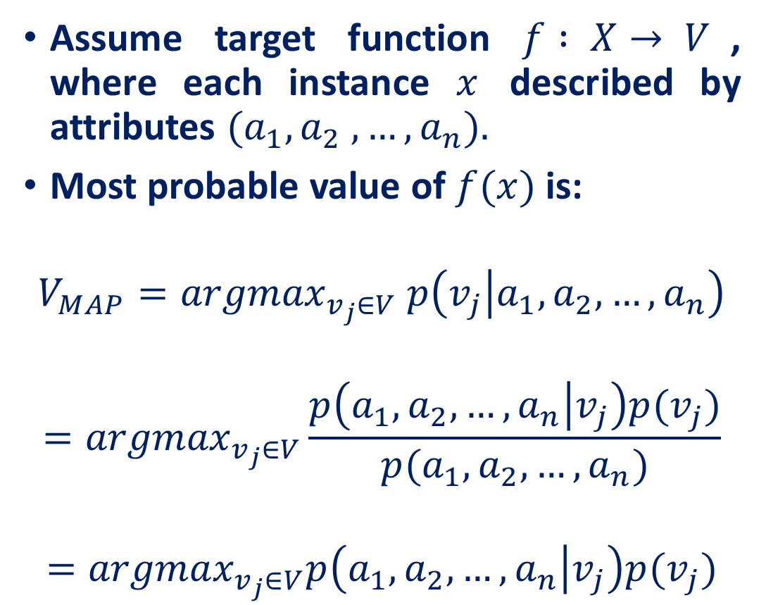
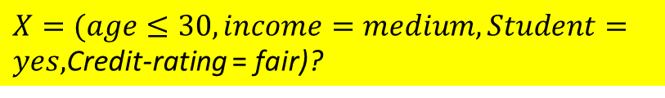

Naive Bayes Classifier
Constant

Slide 18
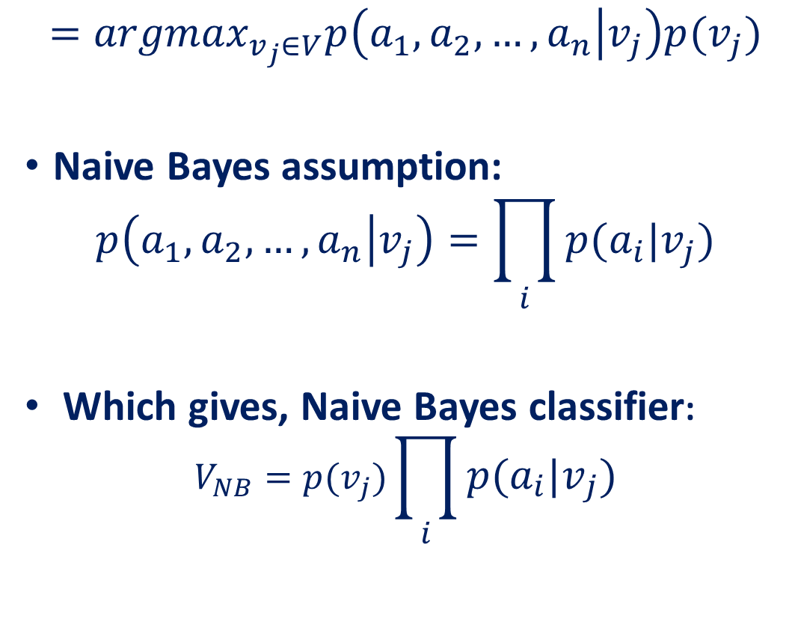
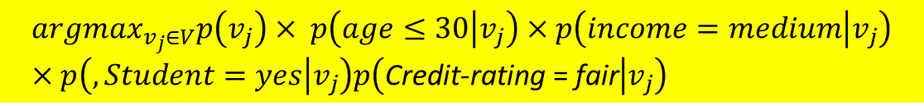
Naive Bayes Classifier

Slide 19
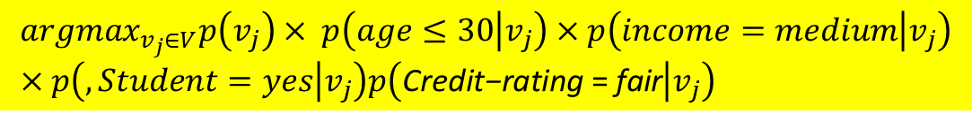
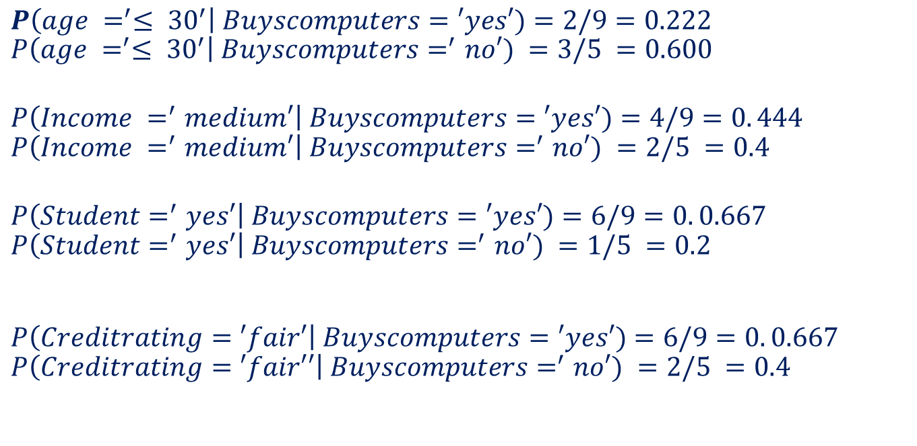
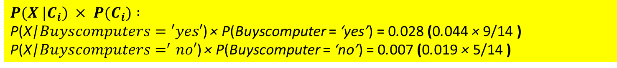
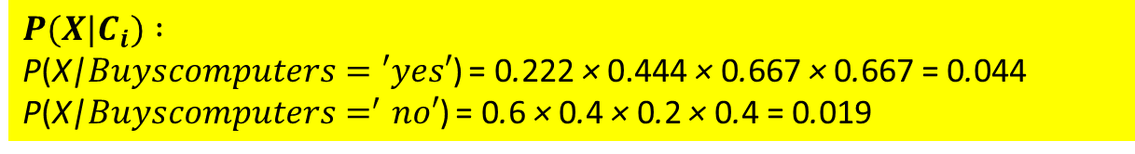
Naive Bayes Classifier
X belongs to class ’buys computer = ’yes’.

Slide 20
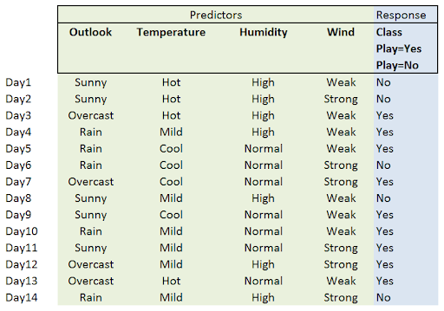
Example
QUESTION:
today = (Sunny, Hot, Normal, weak)
Predict the response.

Slide 21
Outlook | YES | NO
Sunny
Overcast
Rain
Temp | YES | NO
Hot
Mild
Cool
Humidity | YES | NO
High
Normal
Play | Count | P()
YES
NO
Wind | YES | NO
Weak
Strong

Slide 23
Reference
Statistics with Economics and Business Applications, Chapter 3 Probability and Discrete Probability Distributions
Modern Business Statistics, Slides by John Loucks
lecture notes on Probability Theory by Phanuel Mariano

